Slide 1
Hands-On: Building the Future
Lana Yarosh
AT&T Research Labs, Florham Park, NJ

Slide 2
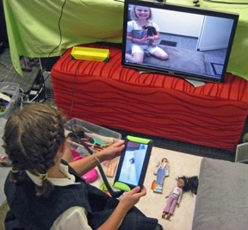
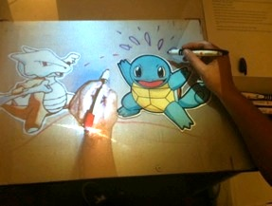
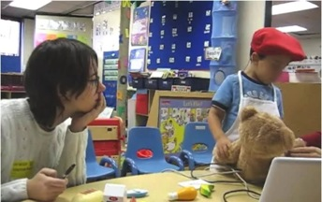
About Me
I’m an inventor at AT&T Research Labs
Ph.D. in a sub-field of Computer Science
Undergraduate in Computer Science and Psychology
My inventions help people can stay close even if they live far apart

Slide 3
How Building the Future Works
  What needs to be different? Notice!
  How can it be better? Imagine It!
  What would that look like? Draw It!
  How can we make it? Build It!
  Did it actually work? Try It Out!

Slide 4
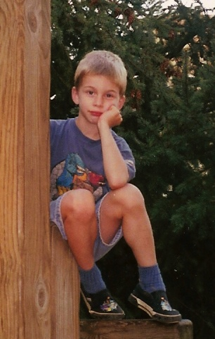
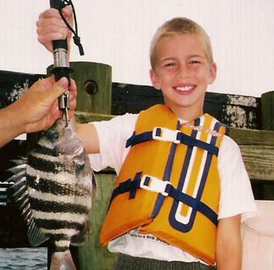
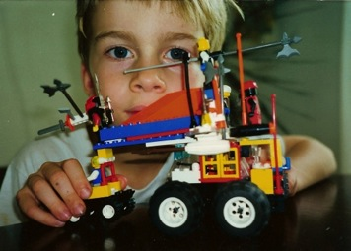
Step 1: Notice What Needs to Be Different
  I moved away from my little brother
  Talking on the phone was boring
  We wanted to do fun things together like read books, play Legos, play board games, and draw together

Slide 5
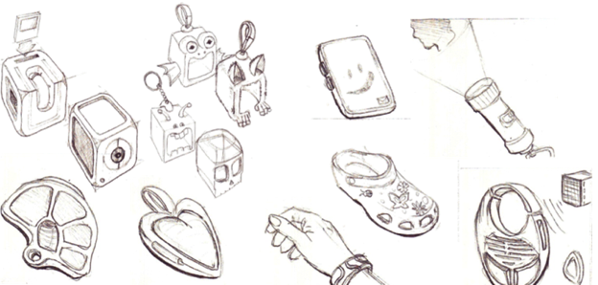
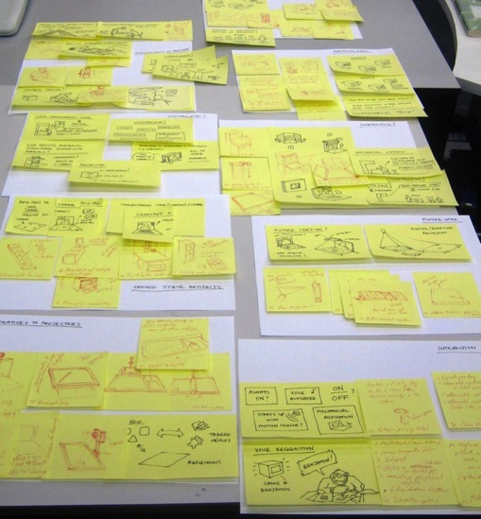
Step 2: Imagine How It Could Be Better

Slide 6
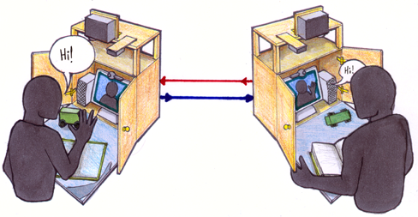
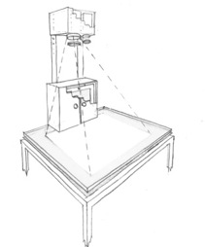
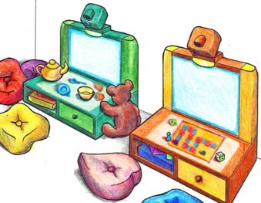
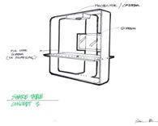
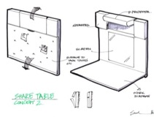
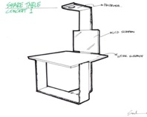
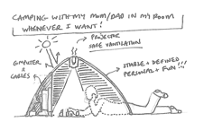
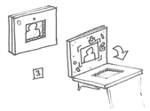
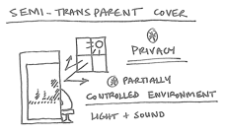
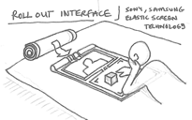
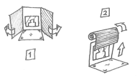
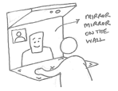
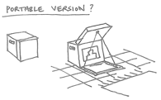
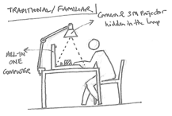
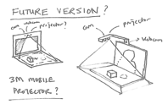
Step 3: Draw What It Would Look Like
Notes:
The final system did not pop out of my head fully formed, but rather was the outcome of several cycles of generating alternatives and getting feedback from families. These are just a few of the sketches from that process…

Slide 7
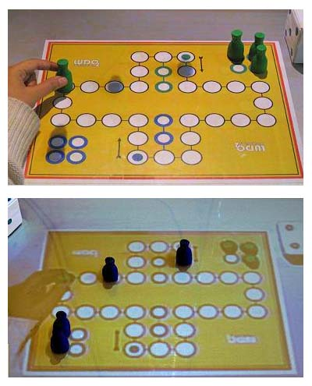
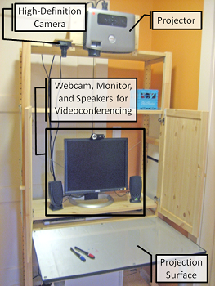
Step 4: Build the Technology
Notes:
The final system did not pop out of my head fully formed, but rather was the outcome of several cycles of generating alternatives and getting feedback from families. These are just a few of the sketches from that process…

Slide 8
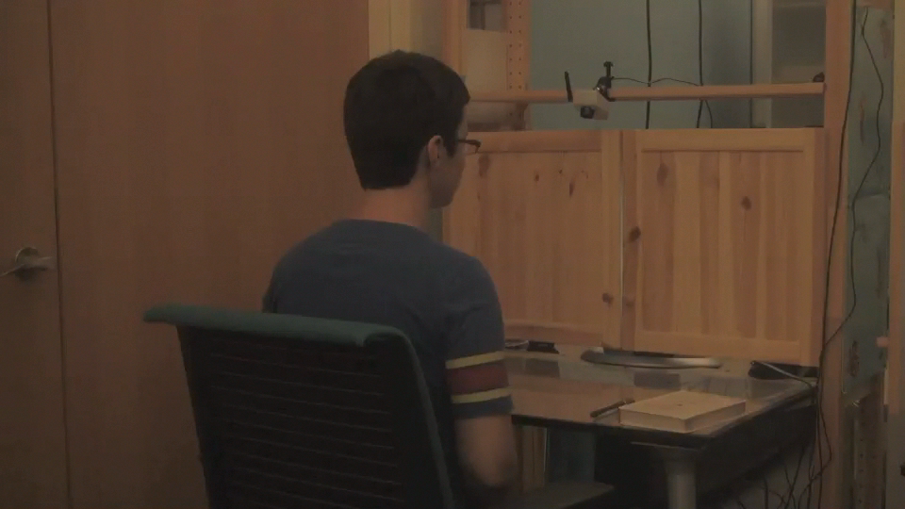
Step 4: Build the Technology
Notes:
The final system did not pop out of my head fully formed, but rather was the outcome of several cycles of generating alternatives and getting feedback from families. These are just a few of the sketches from that process…

Slide 9
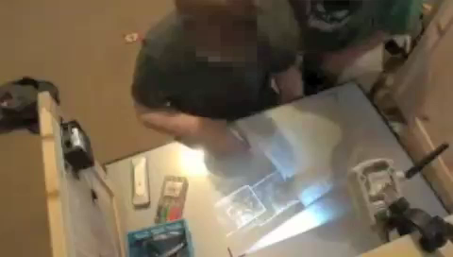
Step 5: Give It to People
Notes:
The final system did not pop out of my head fully formed, but rather was the outcome of several cycles of generating alternatives and getting feedback from families. These are just a few of the sketches from that process…

Slide 10
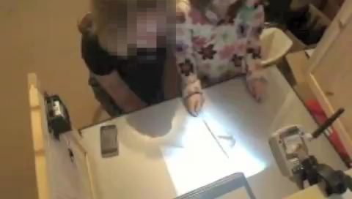
Step 5: Give It to People
Notes:
The final system did not pop out of my head fully formed, but rather was the outcome of several cycles of generating alternatives and getting feedback from families. These are just a few of the sketches from that process…

Slide 11
Your Mission…
  What needs to be different? Notice!
  How can it be better? Imagine It!
  What would that look like? Draw It!
  How can we make it? Build It!
  Did it actually work? Try It Out!
Don’t Worry About:
Whether you’re a good artist
If it’s actually possible to make (think MAGIC!)
If it would cost too much (think infinite $$)

Slide 12
If you enjoyed this and want to do more inventing, leave me your email here or email me, lana@research.att.com
Notes:
That’s it. Thank you for your time.

