Slide 1
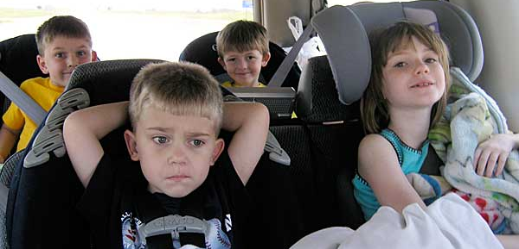
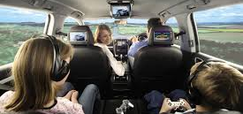
Super Car Trip Team
Think of an invention to help solve this problem:
Long car rides are boring!
How can we make car rides more fun?
First, come up with at least 5 crazy ideas!
Then, draw one idea out.
Remember, you don’t have to worry about how the tech would actually work. Feel free to come up with robots, “magic” devices, holograms, and anything you can think of!

Slide 2
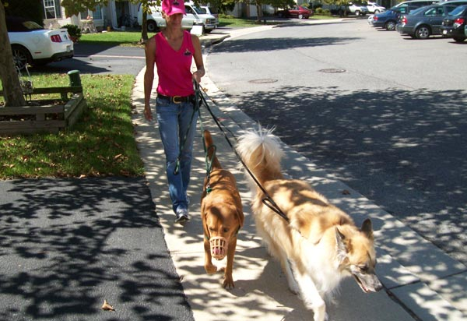
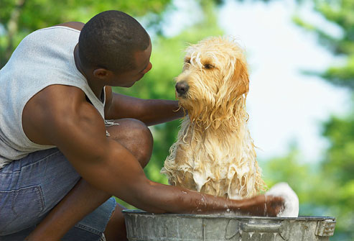
Super Pet Pamper Team
Think of an invention to help solve this problem:
Taking care of a pet can be a lot of work! How can we help families take care of their pets?
First, come up with at least 5 crazy ideas!
Then, draw one idea out.
Remember, you don’t have to worry about how the tech would actually work. Feel free to come up with robots, “magic” devices, holograms, and anything you can think of!

Slide 3
Super Homework Helper Team
Think of an invention to help solve this problem:
Homework can be hard!
How can we help kids do their homework?
First, come up with at least 5 crazy ideas!
Then, draw one idea out.
Remember, you don’t have to worry about how the tech would actually work. Feel free to come up with robots, “magic” devices, holograms, and anything you can think of!

Slide 4
Super Language Learner Team
Think of an invention to help solve this problem:
Learning a new language is tough! How can we help kids learn a new language?
First, come up with at least 5 crazy ideas!
Then, draw one idea out.
Remember, you don’t have to worry about how the tech would actually work. Feel free to come up with robots, “magic” devices, holograms, and anything you can think of!

Slide 5
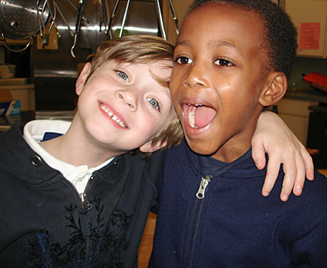
Super BFF Team
Think of an invention to help solve this problem:
Sometimes best friends move away. How can we help friends play together when they don't live close?
First, come up with at least 5 crazy ideas!
Then, draw one idea out.
Remember, you don’t have to worry about how the tech would actually work. Feel free to come up with robots, “magic” devices, holograms, and anything you can think of!

Slide 6
Super New School Helper Team
Think of an invention to help solve this problem:
It's hard to make friends if you move to a new school. How can we help shy kids make new friends?
First, come up with at least 5 crazy ideas!
Then, draw one idea out.
Remember, you don’t have to worry about how the tech would actually work. Feel free to come up with robots, “magic” devices, holograms, and anything you can think of!

